Slide 1

Applied Data Science Capstone
By Michael Martirosian

Slide 2
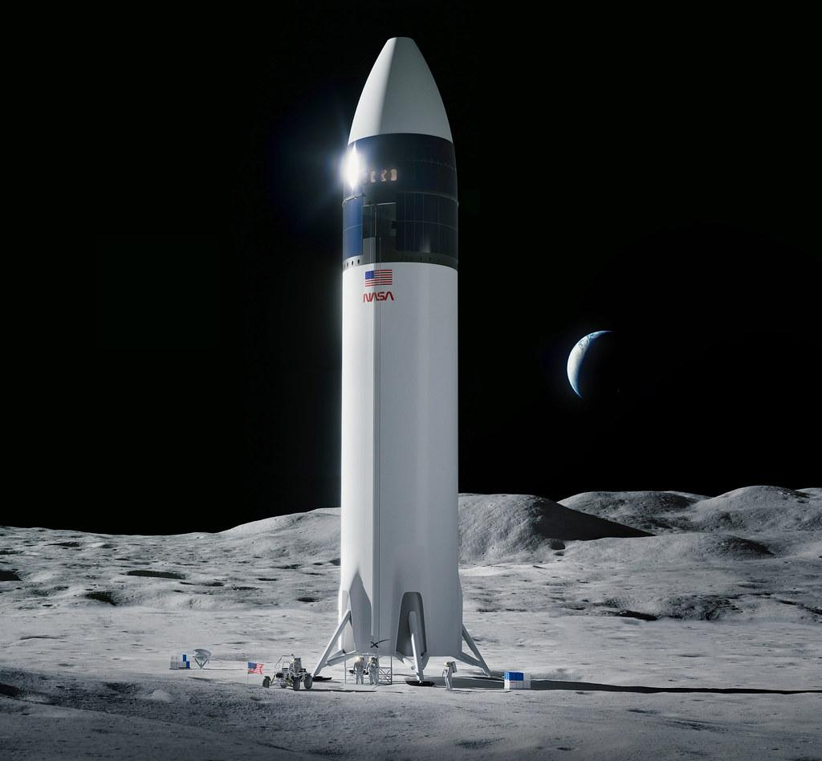
Overview
Executive Summary
Introduction
Methodology
Results
Discussion
Conclusion

Slide 3
Executive Summary
In this final project, we will use machine learning categorization methods to forecast whether the SpaceX Falcon 9 first stage will safely launch.
The following are the major stages in this project:
Info gathering, manipulation, and style
Analyzing exploratory data
Data representation that is interactive
Prediction using machine learning
Our diagrams demonstrate that certain aspects of rocket launches are related to the success or failure of the launches.
It is also determined that the decision tree is the finest machine learning method for predicting whether the Falcon 9 first stage will safely land.

Slide 4
Introduction
In this capstone, we will forecast whether the Falcon 9 first stage will safely land. SpaceX offers Falcon 9 rocket flights on its website for 62 million dollars; other providers charge up to 165 million dollars each; much of the savings is due to SpaceX's ability to reuse the first stage. As a result, if we can predict whether the first stage will land, we can estimate the expense of a flight. This data can be used if another business wishes to compete with SpaceX for a rocket launch.
01
02
The majority of failed landings are premeditated. SpaceX will occasionally execute a controlled descent in the ocean.
03
The primary issue we are attempting to answer is whether, for a given set of Falcon 9 rocket launch characteristics such as cargo mass, trajectory type, launch location, and so on, the first stage of the rocket will safely land.

Slide 5
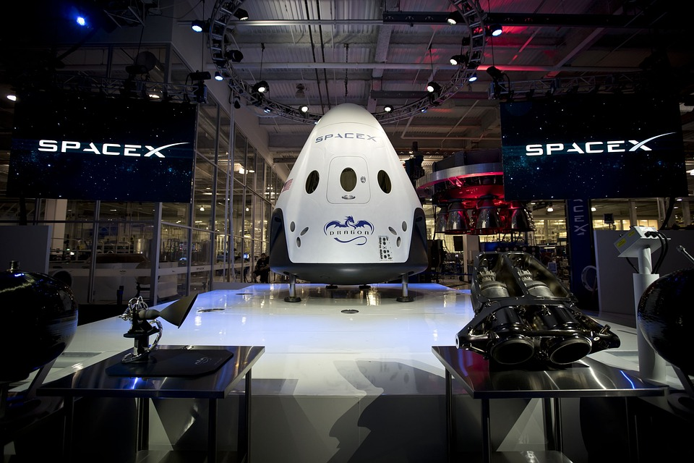
Methodology
The overall methodology includes:
Data collection, wrangling, and formatting, using:
SpaceX API
Web scraping
Exploratory data analysis (EDA), using:
Pandas and NumPy
SQL
Data visualization, using:
Matplotlib and Seaborn
Folium
Dash
Machine learning prediction, using
Logistic regression
Support vector machine (SVM)
Decision tree
K-nearest neighbors (KNN)

Slide 6
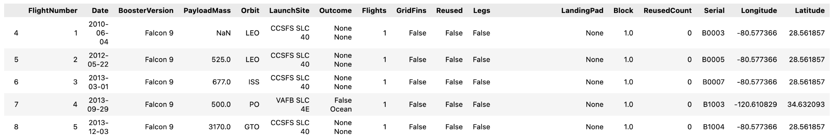
Methodology
Pt.1 Data collection, wrangling, and formatting
API for SpaceX
The URL for the API is https://api.spacexdata.com/v4/rockets/.
The API gives data on many different kinds of SpaceX rocket flights; the data is thus limited to include only Falcon 9 deployments.
Every missing number in the data is substituted by the mean of the column to which it corresponds.
We have 90 rows or instances and 17 columns or features at the conclusion. The image on the right depicts the first few rows of data:

Slide 7
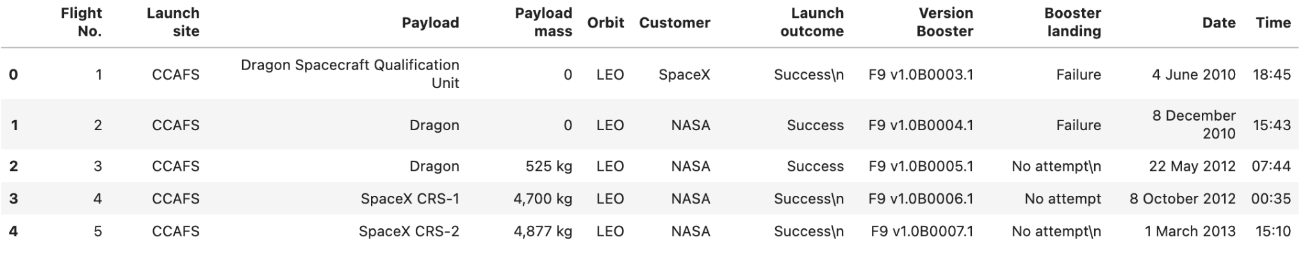
Methodology
Pt.1 Data collection, wrangling, and formatting
Web scraping
The data is scraped from https://en.wikipedia.org/w/index.php?title=List_of_Falcon_9_and_Falcon_Heavy_launches&oldid=1027686922
The website contains only the data about Falcon 9 launches.
We end up with 121 rows or instances and 11 columns or features. The picture below shows the first few rows of the data:

Slide 8

Methodology
Pt.1 Data collection, wrangling, and formatting
The data is later processed so that there are no missing entries and categorical features are encoded using one-hot encoding.
An extra column called ‘Class’ is also added to the data frame. The column ‘Class’ contains 0 if a given launch is failed and 1 if it is successful.
In the end, we end up with 90 rows or instances and 83 columns or features.

Slide 9


Methodology
Pt.2 Exploratory Data Analysis (EDA)
Pandas and NumPy
Functions from the Pandas and NumPy libraries are used to derive basic information about the data collected, which includes:
The number of launches on each launch site
The number of occurrence of each orbit
The number and occurrence of each mission outcome
SQL
The data is queried using SQL to answer several questions about the data such as:
The names of the unique launch sites in the space mission
The total payload mass carried by boosters launched by NASA (CRS)
The average payload mass carried by booster version F9 v1.1

Slide 10


Methodology
Pt.3 Data Visualization
Matplotlib and Seaborn
Functions from the Matplotlib and Seaborn libraries are used to visualize the data through scatterplots, bar charts, and line charts.
The plots and charts are used to understand more about the relationships between several features, such as:
The relationship between flight number and launch site
The relationship between payload mass and launch site
The relationship between success rate and orbit type
Folium
Functions from the Folium libraries are used to visualize the data through interactive maps.
The Folium library is used to:
Mark all launch sites on a map
Mark the succeeded launches and failed launches for each site on the map
Mark the distances between a launch site to its proximities such as the nearest city, railway, or highway

Slide 11

Methodology
Pt.3 Data Visualization
Dash
Functions from Dash are used to generate an interactive site where we can toggle the input using a dropdown menu and a range slider.
Using a pie chart and a scatterplot, the interactive site shows:
The total success launches from each launch site
The correlation between payload mass and mission outcome (success or failure) for each launch site

Slide 12

Methodology
Pt.4 Machine Learning Prediction
Functions from the Scikit-learn library are used to create our machine learning models.
The machine learning prediction phase include the following steps:
Standardizing the data
Splitting the data into training and test data
Creating machine learning models, which include:
Logistic regression
Support vector machine (SVM)
Decision tree
K nearest neighbors (KNN)
Fit the models on the training set
Find the best combination of hyperparameters for each model
Evaluate the models based on their accuracy scores and confusion matrix

Slide 13
Results
The results are split into 5 sections:
SQL (EDA with SQL)
Matplotlib and Seaborn (EDA with Visualization)
Folium
Dash
Predictive Analysis
In all of the graphs that follow, class 0 represents a failed launch outcome while class 1 represents a successful launch outcome.

Slide 14
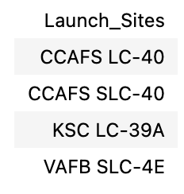
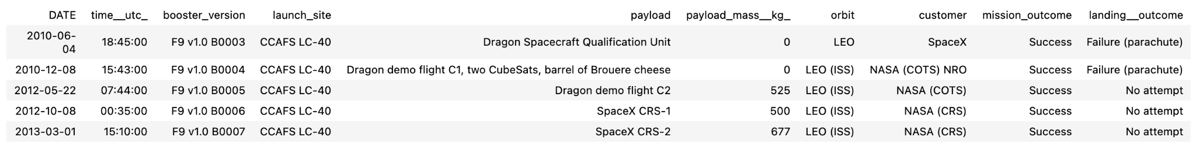
Results
SQL (EDA with SQL)
The names of the unique launch sites in the space mission
5 records where launch sites begin with ‘CCA’

Slide 15

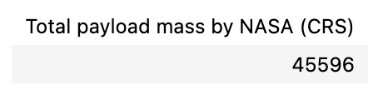
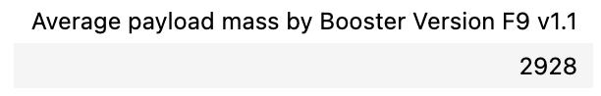
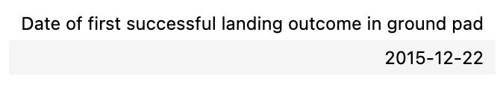
Results
SQL (EDA with SQL)
The total payload mass carried by boosters launched by NASA (CRS)
The average payload mass carried by booster version F9 v1.1
The date when the first successful landing outcome in ground pad was achieved

Slide 16
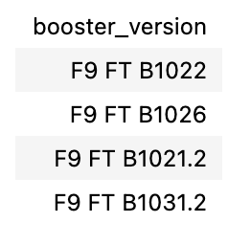
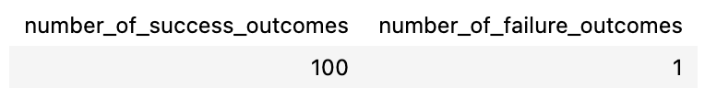
Results
SQL (EDA with SQL)
The names of the boosters which have success in drone ship and have payload mass greater than 4000 but less than 6000
The total number of successful and failure mission outcomes

Slide 17
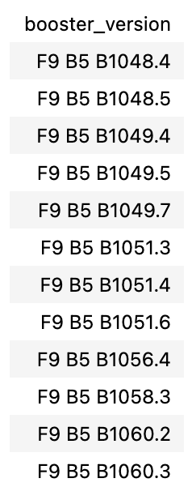
Results
SQL (EDA with SQL)
The names of the booster versions which have carried the maximum payload mass

Slide 18
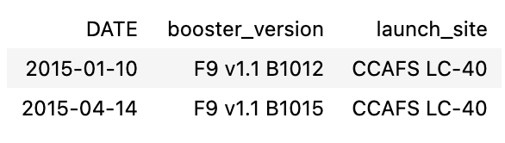
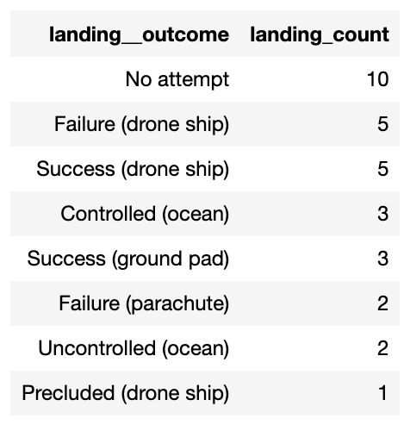
Results
SQL (EDA with SQL)
The failed landing outcomes in drone ship, their booster versions, and launch site names for in year 2015
The count of landing outcomes between the date 2010-06-04 and 2017-03-20, in descending order

Slide 19
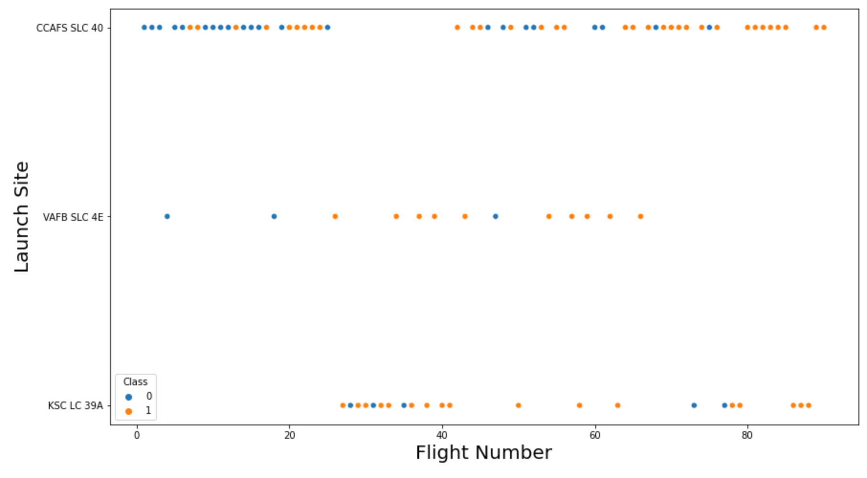
Results
Matplotlib and Seaborn (EDA with Visualization)
The relationship between flight number and launch site

Slide 20
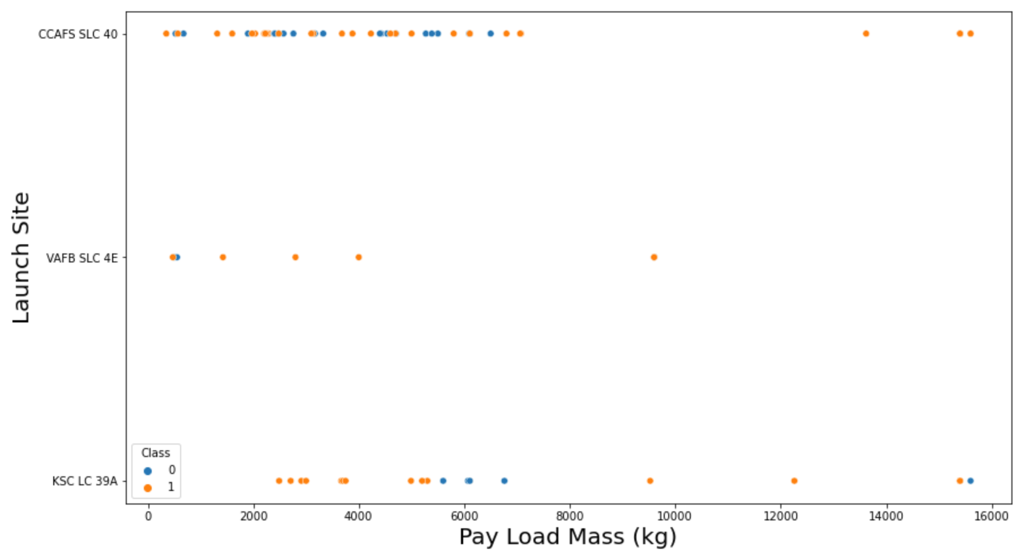
Results
Matplotlib and Seaborn (EDA with Visualization)
The relationship between payload mass and launch site

Slide 21
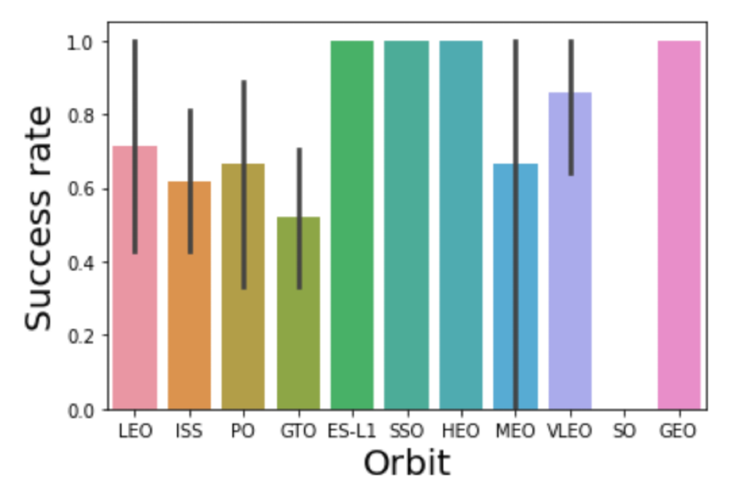
Results
Matplotlib and Seaborn (EDA with Visualization)
The relationship between success rate and orbit type

Slide 22
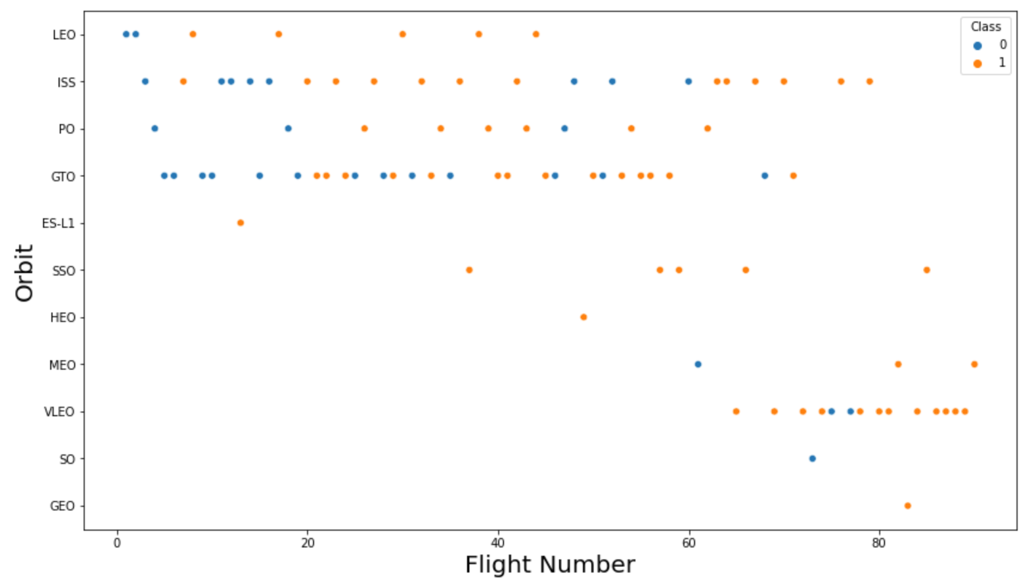
Results
Matplotlib and Seaborn (EDA with Visualization)
The relationship between flight number and orbit type

Slide 23
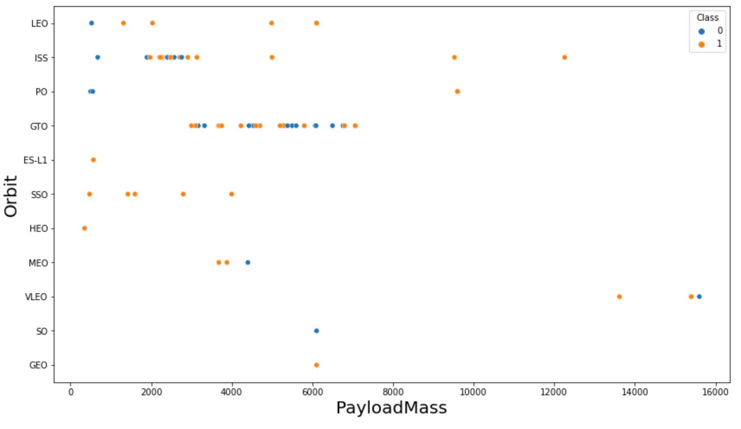
Results
Matplotlib and Seaborn (EDA with Visualization)
The relationship between payload mass and orbit type

Slide 24
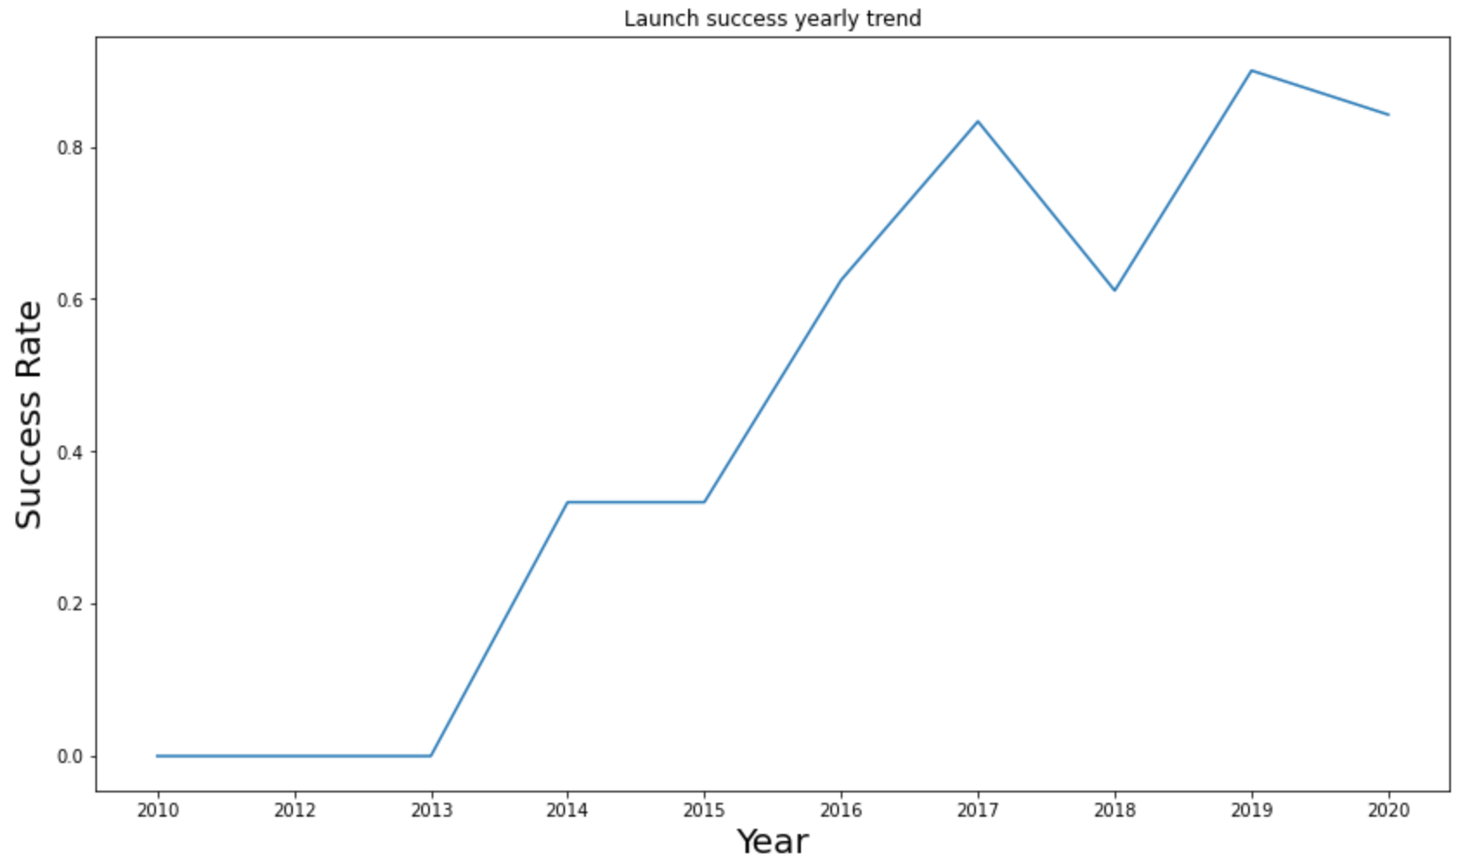
Results
Matplotlib and Seaborn (EDA with Visualization)
The launch success yearly trend

Slide 25
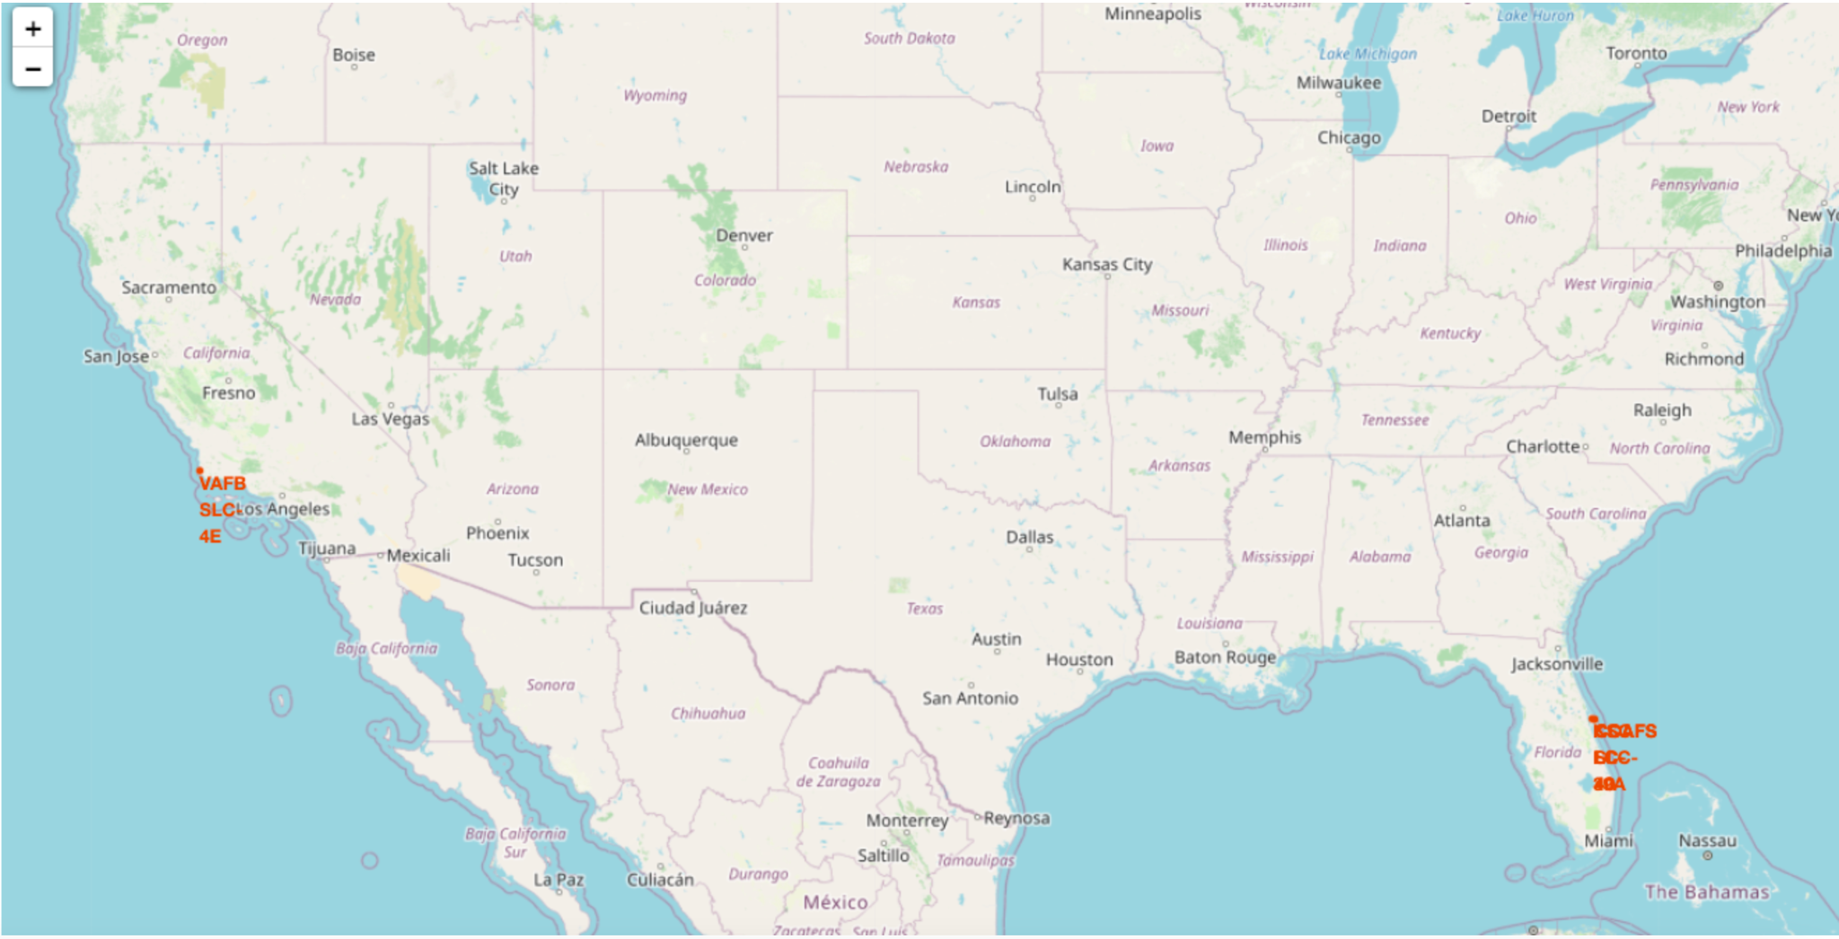
Results
Folium
All launch sites on map

Slide 26
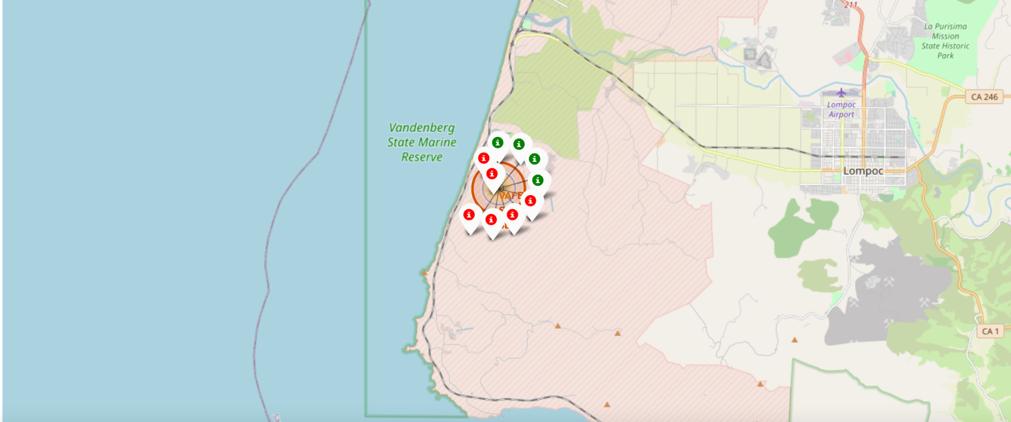
Results
Folium
The succeeded launches and failed launches for each site on map
If we zoom in on one of the launch site, we can see green and red tags. Each green tag represents a successful launch while each red tag represents a failed launch

Slide 27
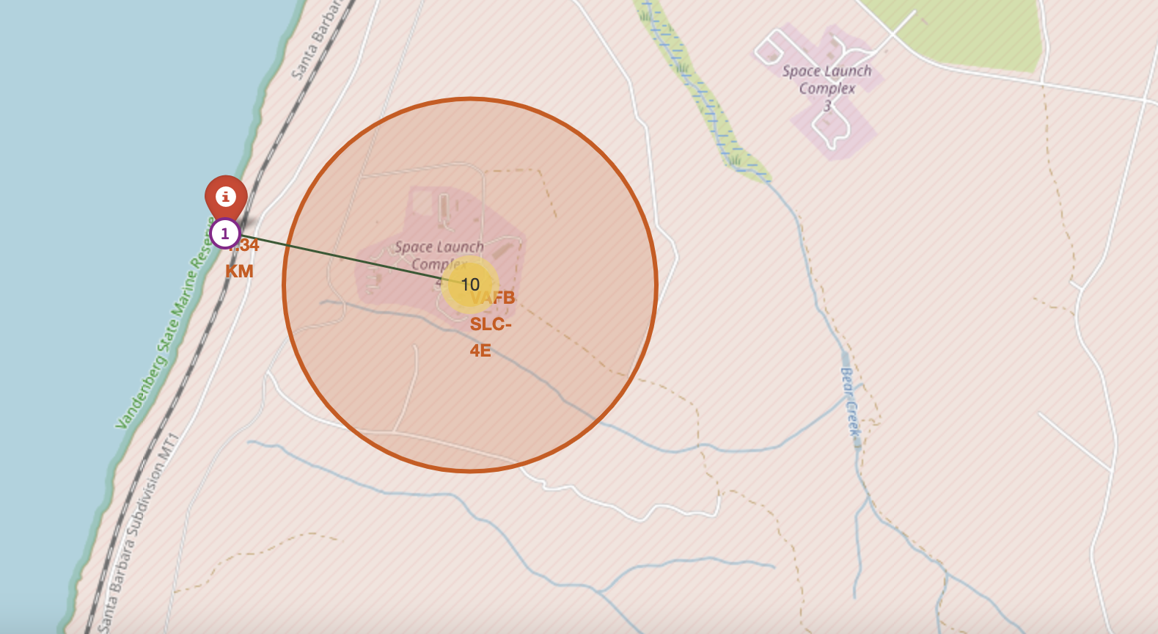
Results
Folium
The distances between a launch site to its proximities such as the nearest city, railway, or highway
The picture below shows the distance between the VAFB SLC-4E launch site and the nearest coastline

Slide 28

Results
Dash
The picture below shows a pie chart when launch site CCAFS LC-40 is chosen.
0 represents failed launches while 1 represents successful launches. We can see that 73.1% of launches done at CCAFS LC-40 are failed launches.

Slide 29
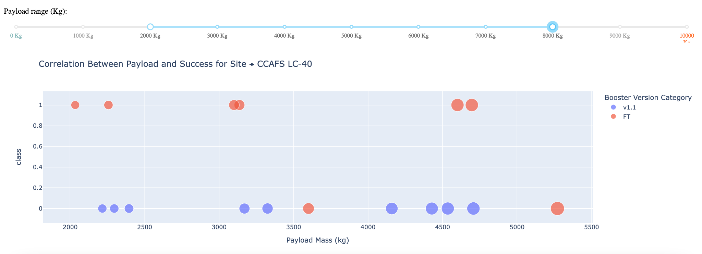
Results
Dash
The picture below shows a scatterplot when the payload mass range is set to be from 2000kg to 8000kg.
Class 0 represents failed launches while class 1 represents successful launches.

Slide 30

Results
Predictive Analysis
Logistic regression
GridSearchCV best score: 0.8464285714285713
Accuracy score on test set: 0.8333333333333334
Confusion matrix:

Slide 31
Results
Predictive Analysis
Support vector machine (SVM)
GridSearchCV best score: 0.8482142857142856
Accuracy score on test set: 0.8333333333333334
Confusion matrix:

Slide 32
Results
Predictive Analysis
Decision tree
GridSearchCV best score: 0.8892857142857142
Accuracy score on test set: 0.8333333333333334
Confusion matrix:

Slide 33
Results
Predictive Analysis
K nearest neighbors (KNN)
GridSearchCV best score: 0.8482142857142858
Accuracy score on test set: 0.8333333333333334
Confusion matrix:

Slide 34
Results
Predictive Analysis
Putting the results of all 4 models side by side, we can see that they all share the same accuracy score and confusion matrix when tested on the test set.
Therefore, their GridSearchCV best scores are used to rank them instead. Based on the GridSearchCV best scores, the models are ranked in the following order with the first being the best and the last one being the worst:
Decision tree (GridSearchCV best score: 0.8892857142857142)
K nearest neighbors, KNN (GridSearchCV best score: 0.8482142857142858)
Support vector machine, SVM (GridSearchCV best score: 0.8482142857142856)
Logistic regression (GridSearchCV best score: 0.8464285714285713)

Slide 35
Results
Predictive Analysis
We can see from the data display portion that some characteristics may have a connection with the mission result in a variety of ways. For example, with heavy payloads, the effective or favorable landing rate is higher in orbit classes such as Polar, LEO, and ISS. However, for GTO, we can't tell the difference because both positive and negative arrival rates (missed missions) are present.
As a result, each feature may have an effect on the ultimate task outcome. It is challenging to determine how each of these characteristics affects the task outcome. However, we can use machine learning techniques to learn the pattern of previous data and forecast whether or not a task will be effective based on the provided features.

Slide 36
CONCLUSION
In this project, we try to predict if the first stage of a given Falcon 9 launch will land in order to determine the cost of a launch.
Each feature of a Falcon 9 launch, such as its payload mass or orbit type, may affect the mission outcome in a certain way.
Several machine learning algorithms are employed to learn the patterns of past Falcon 9 launch data to produce predictive models that can be used to predict the outcome of a Falcon 9 launch.
The predictive model produced by decision tree algorithm performed the best among the 4 machine learning algorithms employed.

Slide 37
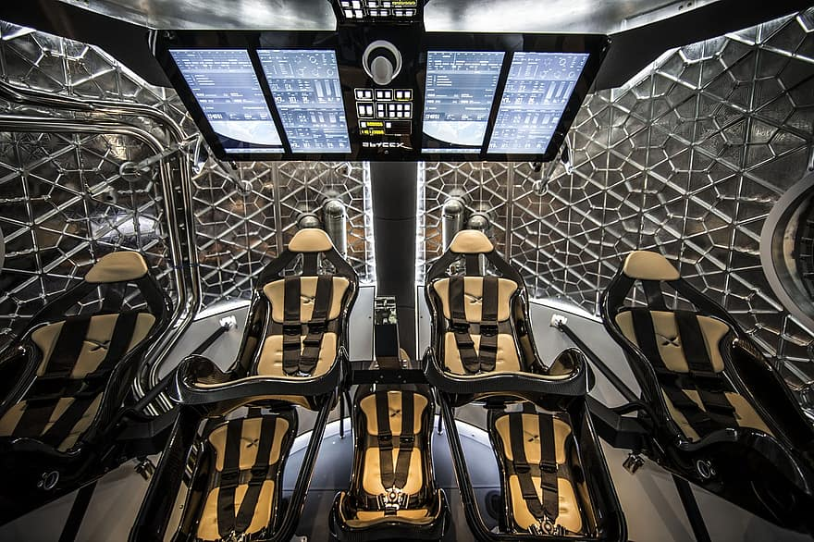
Thank you!
Michael Martirosian

